Slide 1
CH-3 ELECTROCHEMISTRY
1. INTRODUCTION
Presented by Dr. Poonam Singh
M.B. PATEL ENG. MED. SEC. & HR.SEC. SCHOOL GANDHINAGAR
Notes:
Presented by –Dr. Poonam Singh
M. B. PATEL ENGLISH MEDIUM SCHOOL

Slide 2
Electrochemistry is the study of
Production of electricity with the help of energy released during Spontaneous chemical reactions.
2.To bring non spontaneous chemical reactions feasible by using electrical energy.
Eg. A large number of metals , NaOH, Chlorinre, Fluorine and
other chemicals are produced by electrochemical methods.
Batteries and fuel cells convert chemical energy into electrical
energy and are used in various instruments.
Importance- Less polluting hence eco-friendly
More efficient.
Transmission of sensory signals through cells to brain and vice versa,
and communication between cells are Electrochemical type.

Slide 3
A large number of chemical reactions used in industries are
based on electrochemical reactions.
Many analytical techniques are based on electrochemical principles.
ELECTROCHEMICAL CELLS
The device in which electrical energy is produced from chemical
reaction is called an Electrochemical cell or a Galvanic cell or
Voltaic cell.
Arrangement is made such a way so as to oxidation and reduction
reactions occur in separate containers called half cells .
Spontaneous redox reaction occurs.

Slide 4
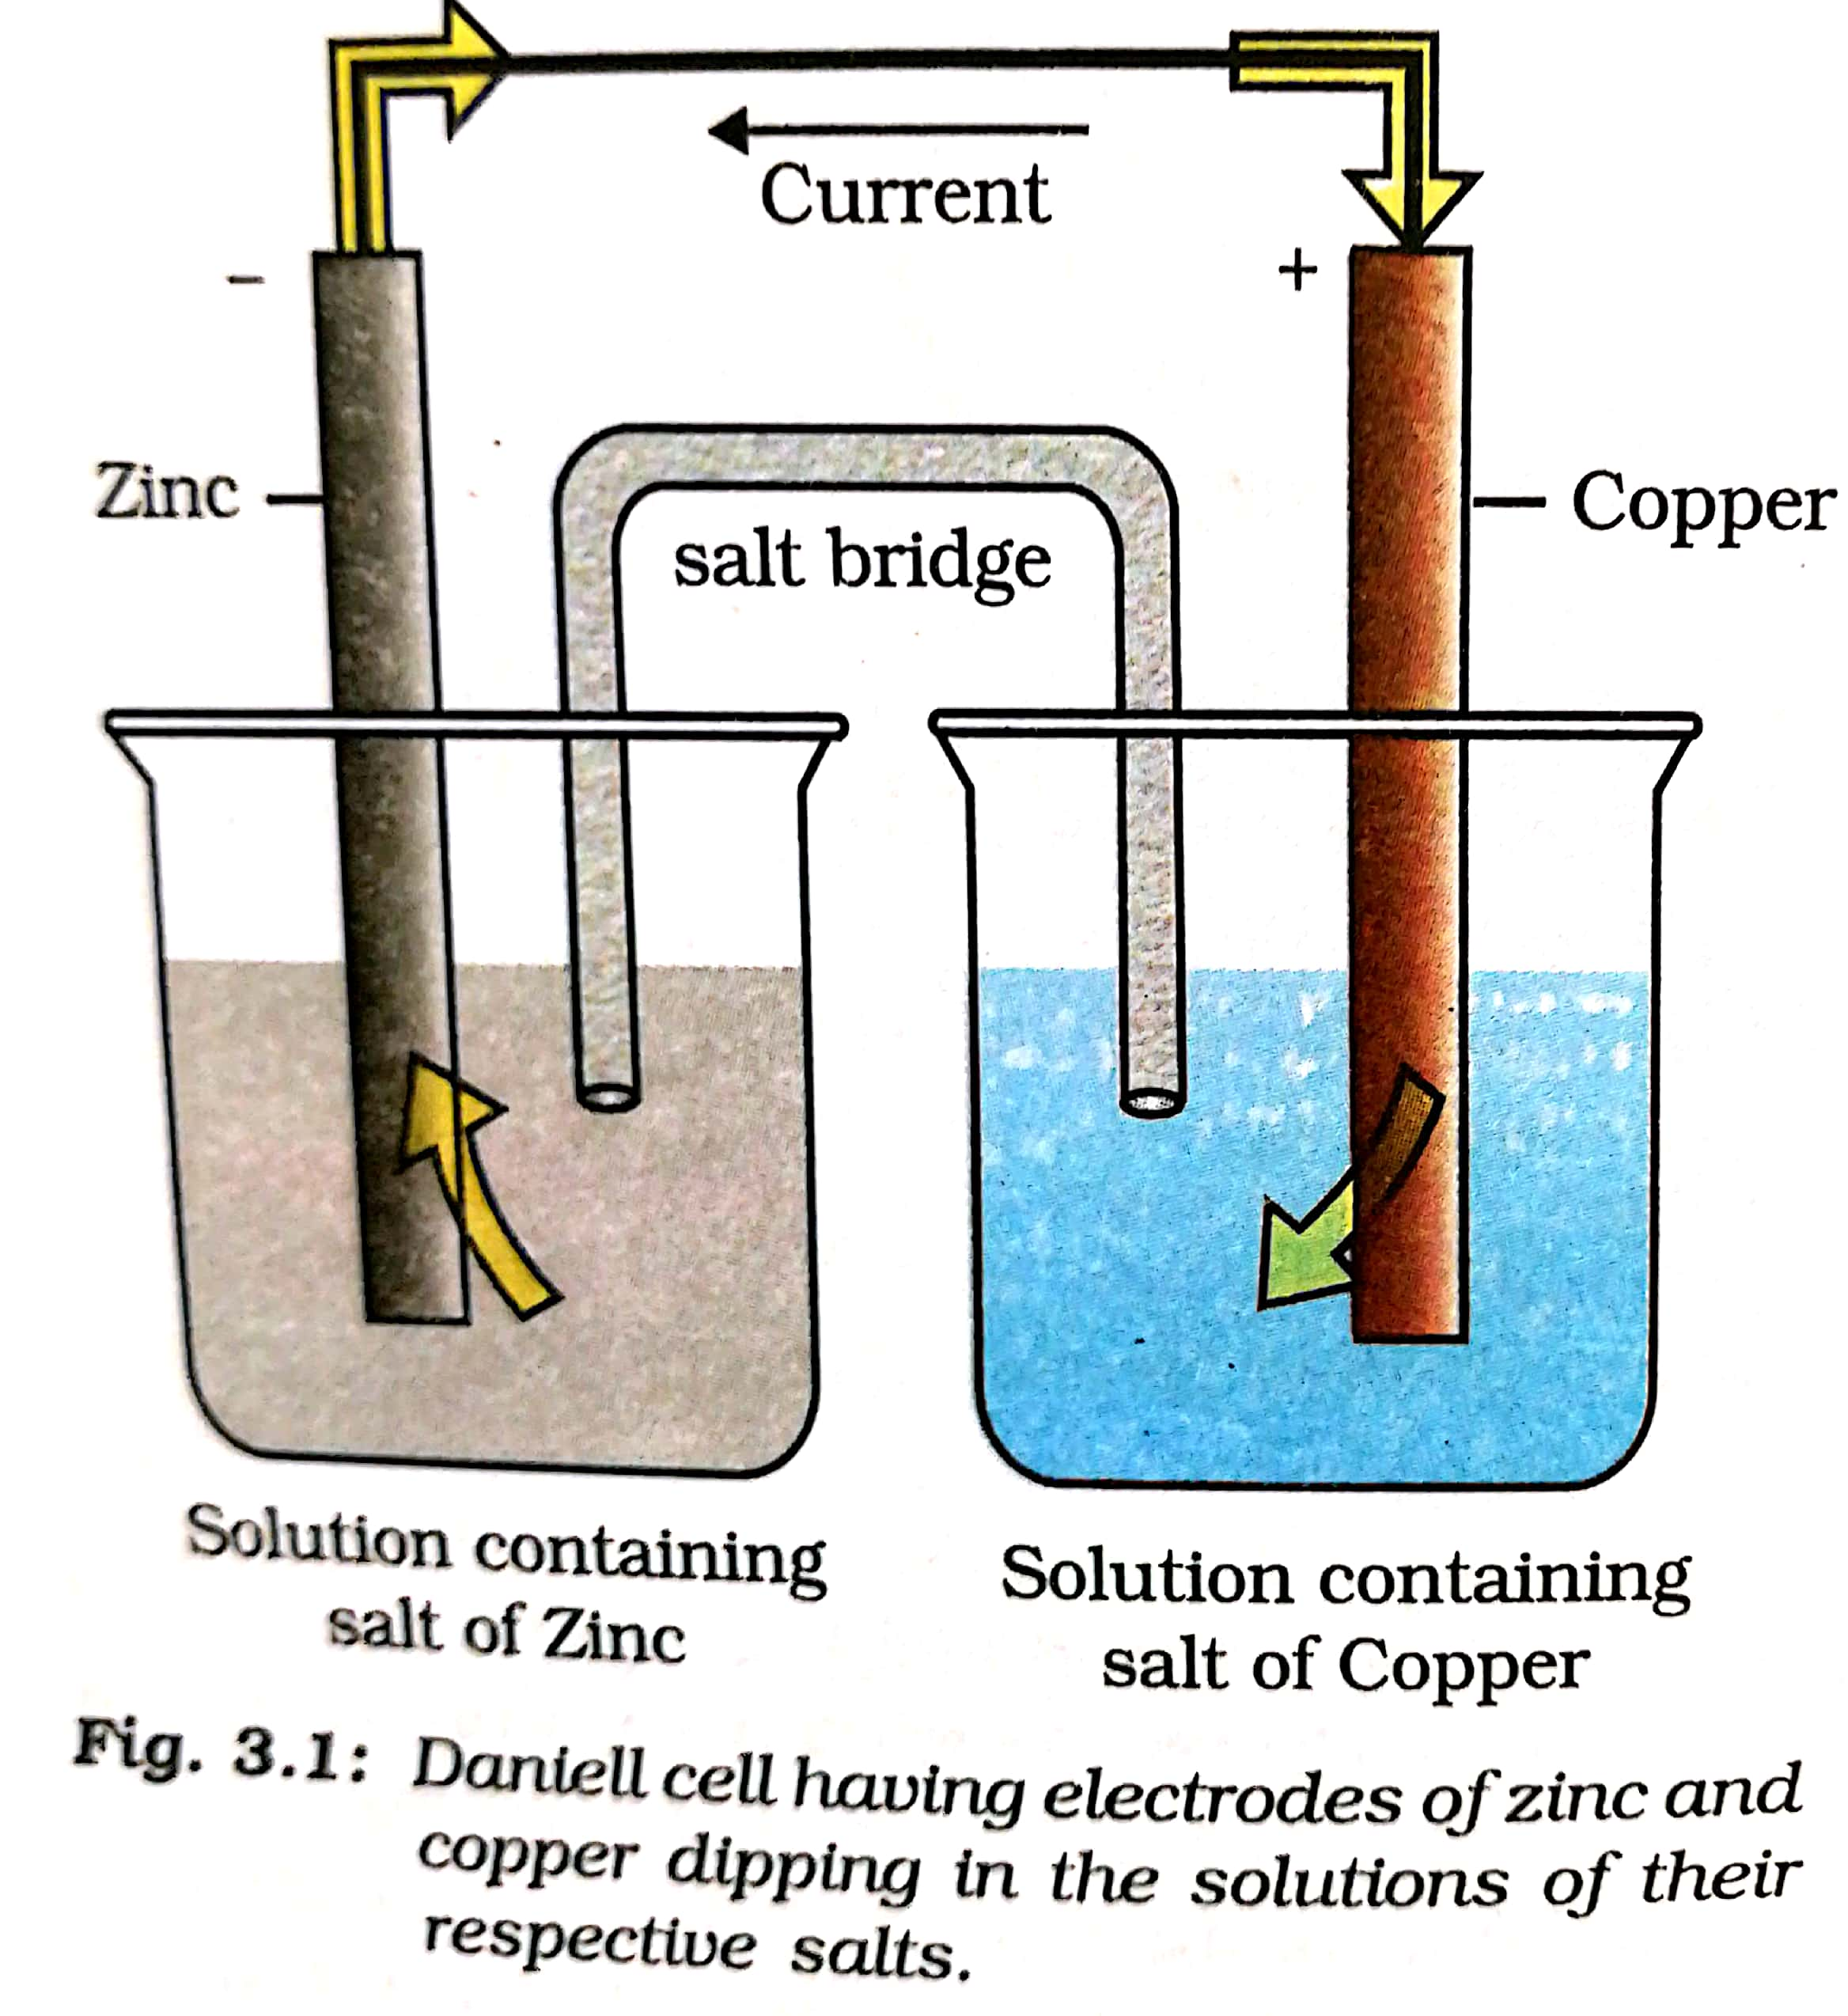

Slide 5
Construction
Take two beaker.
Beaker A contain 1 M aqueous solution ofZnSO4 and a strip of Zn dipped in it is expressed as Zn (s)/ Zn 2+(aq)
Beaker B contain 1 M aqueous solution CuSO4 and
a strip of Cu dipped in it,
Expressed as Cu(s) /Cu2+ (aq).
The vertical bar indicates contact between Zn strip and Zn2+ ion
Cu strip and Cu 2+ ion.
Both the set up is called half cell.
A salt bridge is is used to complete the (internal ) electrical circuit
and connects the two solutions.

Slide 6
A salt bridge is a U shaped tube filled with aqueous solution of NH4NO3(or KNO3).
Two open ends are sealed with glass wool (or cotton plugs).
Metallic strips are connected externally to ammeter or galvanometer
by a insulated wire.
Galvanometer indicates the direction of the flow of electric current
while ammeter measures electric current.
The electrode on which reduction reaction occurs is called cathode(+)
and the one on which oxidation reaction occurs is called anode (-).
When the two electrodes connected externally(by a wire), the current
of electrons flows from anode to cathode. The flow of current in the
solution of U tube occurs through ions.
By convention the direction of electric current (is opposite to the
flow of electrons.

